Slide 1
A Data Story of Films
Andreas Lemos, Omar Kapur, & Sam Williams

Slide 2
The Dataset
1000 popular movies between 2006 to 2016
The title of the film
Title
Sample: Suicide Squad
A comma-separated list of genres used to classify the film
Genre
Sample: Action,Adventure,Fantasy
The name of the film's director
Director
Sample: M. Night Shyamalan
A comma-separated list of the main stars of the film
Actors
Sample: Chris Pratt, Vin Diesel, Bradley Cooper, Zoe Saldana
Movie revenue in millions
Revenue (Millions)
Sample: 368.31

Slide 3
Research Questions
1
What factors have an immediately noticeable impact on revenue within the data?
PRODUCTION
2
How does revenue change by genre?
SCENE
ROLL
TAKE
3
DIRECTOR
Can a director make a film more successful?
CAMERA
DATE
PROD.CO.

Slide 4
Analysis Approach
Diving into the Data
Data Analysis
Try to answer Research Design questions and sub-questions by analyzing the organized data
Initial Dataset
Data Preparation
1000 rows (movies)
12 columns (variables)
Genre and Actors are comma separated lists. These had to be migrated into dummy variables
Data Cleansing
128 rows removed due to not having Revenue information
64 rows removed due to not having Metascore information

Slide 5
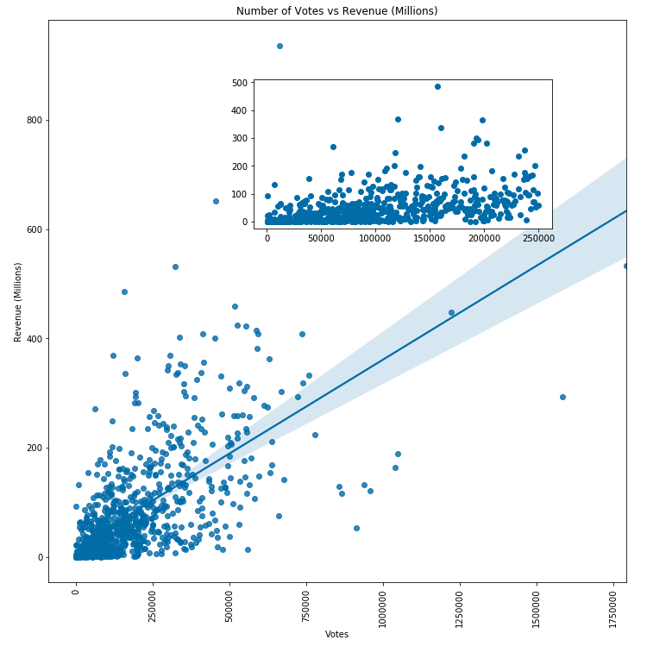
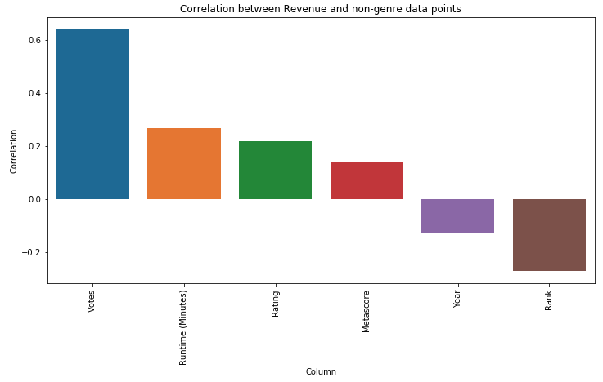
Question 1
What factors have an immediately noticeable impact on revenue within the data?

Slide 6
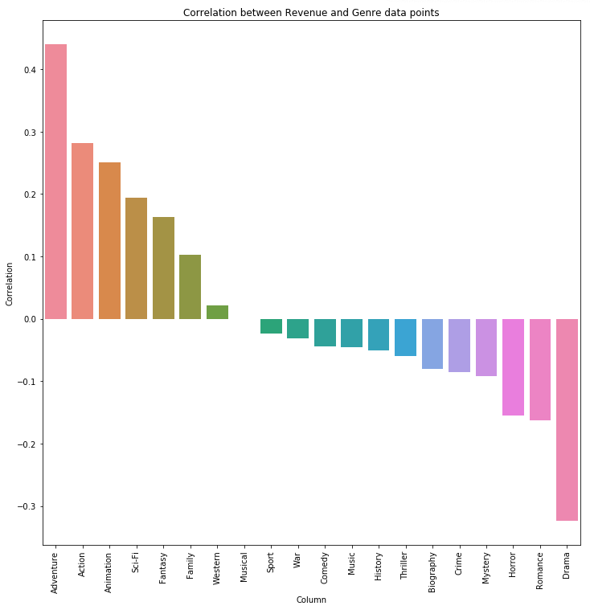
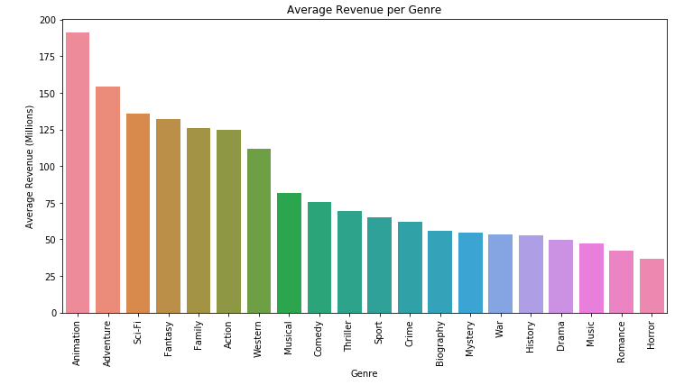
Question 2
How does revenue change by genre?

Slide 7
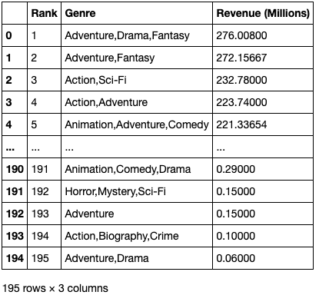
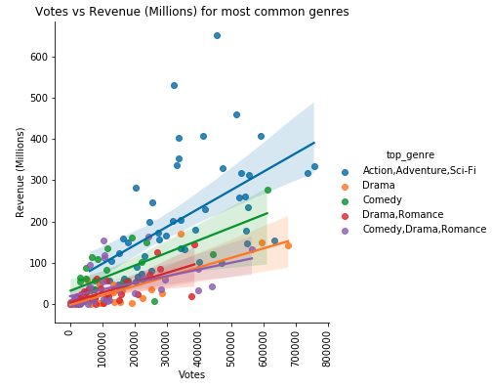
Question 2 (cont.)
How does revenue change by genre?

Slide 8
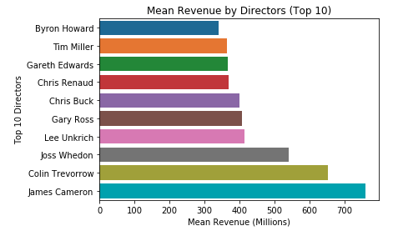
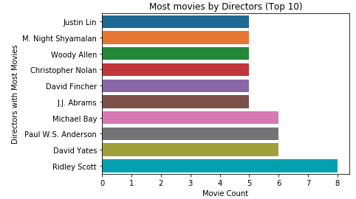
Question 3
Can a director make a film more successful?

Slide 9
Summary
Most Influential Factors
Votes and Runtime are the most important factors when determining Revenue for this dataset
Some genres perform better than others in terms of Revenue
Challenges
Limiting the scope to not include Statistical inference
Only one dataset limits our analysis options
Complex plots are hard to create in python
Next Steps
Additional data points such as Cost information
Better categorization of genres
Add seasonality data to dataset, along with time series data on Revenue

Slide 10
THANK YOU
W200 | Spring 2020 | Thursday 4 PM | Project 2 | Andreas Lemos, Omar Kapur, & Sam Williams

